Slide 1

ABE 715
Computer Programming
Lecture 3: Control Flow & Logic
Conditionals: If, Else, and Engineering Decision Making
Dr. Kadeghe G. Fue
Department of Agricultural Engineering
1

Slide 2
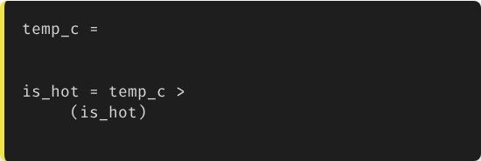
Recap: Booleans & Comparison
In Lecture 2, we learned about Data Types and comparison operators. Remember, these comparisons create Boolean values.
35.0
True (1)
# Is it too hot?
30.0
False (0)
print
# Output: True
Today, we use these True/False results to control the flow of our program.
2

Slide 3

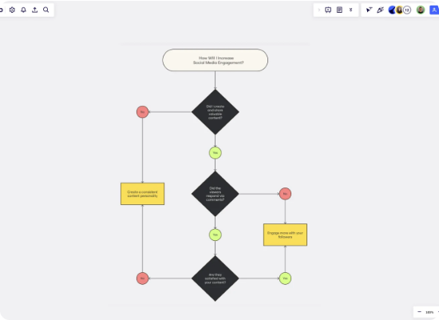
Visualizing Decisions: Flowcharts
The "Branch"
A program usually runs from top to bottom. Control flow allows the code to "branch" into different paths based on data.
This mimics engineering systems:
"If the tank is full, stop the pump. Otherwise, keep pumping."
3

Slide 4
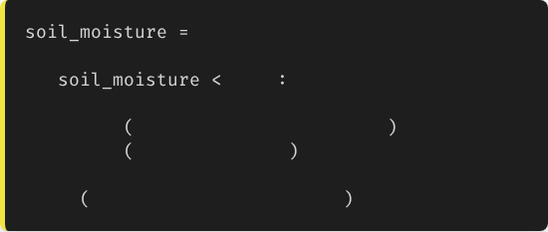
The if Statement
Syntax Essentials
In Python, the structure is strictly defined by indentation.
15.5
1.
The if keyword.
if
20.0
# This runs ONLY if True
2.
The condition (comparison).
print
"Warning: Soil is dry!"
print
"Open Valve 1"
3.
A colon :.
print
"System Check Complete"
4.
Indented block of code (usually 4 spaces).
If you forget the indentation, Python will give an error!
4

Slide 5
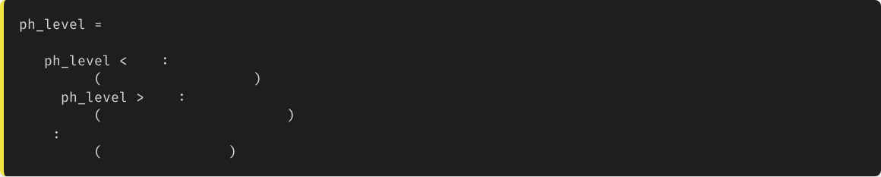
Branching: else and elif
What if we have multiple conditions?
7.5
if
6.0
print
"Acidic: Add Lime"
elif
8.0
print
"Alkaline: Add Sulfur"
else
print
"pH is Optimal"
The computer checks them in order. As soon as one is True, it executes that block and skips the rest.
5

Slide 6


Logical Operators
and
or
not
Both conditions must be True.
At least one condition must be True.
Inverses the boolean value.
e.g., Moisture is Low AND It is Night.
e.g., Valve is NOT Open.
e.g., Tank is Empty OR Manual Override is On.
6

Slide 7
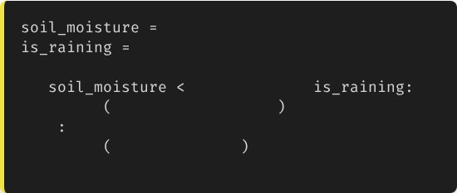
Combining Logic
Real-world Precision
18.0
True
In irrigation engineering, we rarely act on a single variable. We combine sensor data to prevent waste.
if
20.0
and not
print
"Start Irrigation"
Scenario: Only water if the soil is dry AND it is not currently raining.
else
print
"Do not water"
# Output: Do not water
7

Slide 8
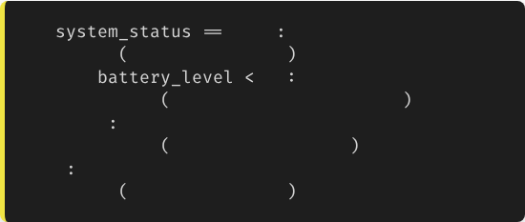
Nested Conditionals
Decision Trees
if
"ON"
print
"System Active"
You can put an if statement inside another if statement. This creates a hierarchy of decision making.
if
10
print
"WARNING: Low Battery"
else
Note: Be careful with indentation! Deeply nested code can be hard to read.
print
"Battery Optimal"
else
print
"System is OFF"
8

Slide 9
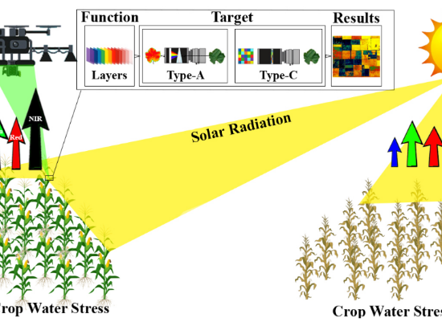
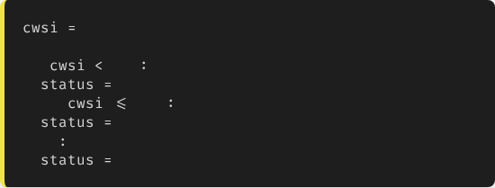
Engineering Case: Crop Water Stress
Problem: Calculate Crop Water Stress Index (CWSI).
•
If CWSI < 0.2: No Stress
•
If CWSI 0.2 - 0.5: Mild Stress
•
If CWSI > 0.5: Severe Stress
0.45
if
0.2
"No Stress"
elif
0.5
"Mild Stress"
else
"Severe Stress"
9

Slide 10
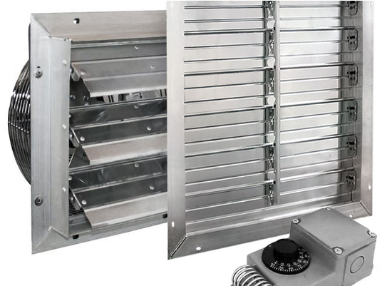
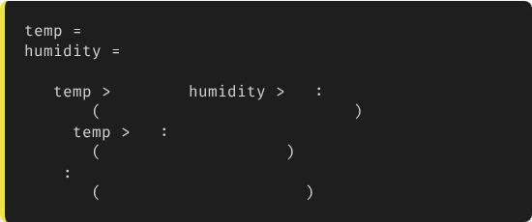
Engineering Case: Greenhouse Control
Temperature & Humidity Logic
We need to manage fans based on Heat Index.
32
80
if
30
and
70
print
"Turn on Fans AND Misters"
elif
30
print
"Turn on Fans only"
else
print
"Natural Ventilation"
10

Slide 11
Common Errors in Logic
•
IndentationError: Failed to indent code inside the if block.
•
Comparison vs Assignment:
Using = (assignment) instead of == (comparison).
if x = 5: (WRONG)
if x == 5: (CORRECT)
•
Logic Errors:
Code runs, but logic is flawed (e.g., using and instead of or).
11

Slide 12





Best Practices
Readability
Avoid Deep Nesting
Test Edge Cases
Avoid extremely long conditions. Use variables to name your booleans.
If you have 4 levels of indentation, consider rewriting your logic.
What happens if the sensor reads exactly 0? Or a negative number? Test boundaries.
12

Slide 13


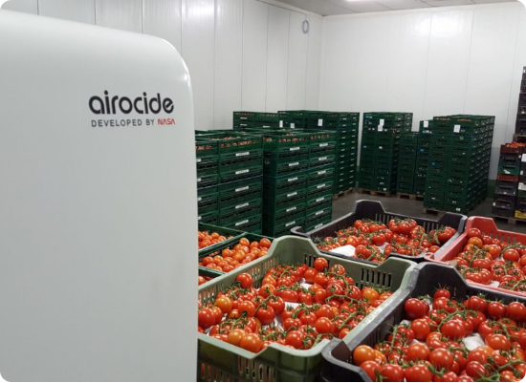
Lecture 3: Take-Home Assignment
Post-Harvest Logic
Task: Write a Python script to monitor a tomato cold storage room.
Conditions:
Ideal Temp: 12°C - 15°C
•
Ideal Humidity: 85% - 95%
Logic:
•
1.
If Temp < 12: "Heater ON"
2.
If Temp > 15: "AC ON"
3.
If Humidity < 85: "Humidifier ON"
13
4.
Else: "Optimal"

Slide 14
Questions?
Next Class: Loops (While and For)
Dr. Kadeghe G. Fue
Department of Agricultural Engineering
14

